Slide 1
Lecture 3
Truncation Errors
Notes:
In this lecture we are going to talk about the second source of errors related to numerical methods: truncation errors

Slide 2
Truncation Errors
Numerical algorithms aim to solve a mathematical problem numerically even if no closed form solution is known
A common approach is to replace the original problem by a simpler one with known solution
The difference between the solution of the actual problem one aims to solve and the solution of the simpler problem is called truncation error
Notes:
Recall that numerical algorithms aim to solve a mathematical problem numerically even if no closed form solution is known.
A common approach is to replace the original problem by a simpler one with known solution
The difference between the solution of the actual problem one aims to solve and the solution of the simpler problem is called truncation error

Slide 3

Taylor Series
An important tool used to estimate truncation errors is the Taylor series expansion
For a function in one variable one has
$$f\left(x+h\right)=f\left(x\right)+{hf}^{′}\left(x\right)+\frac{h^{2}}{2!}f"(x)+⋯$$
Notes:
An commonly used tool to estimate truncation errors are Taylor series
Recall that the Taylor series expansion for a function in one variable is given by:
$$f\left(x+h\right)=f\left(x\right)+{hf}^{′}\left(x\right)+\frac{h^{2}}{2!}f"(x)+⋯$$

Slide 4








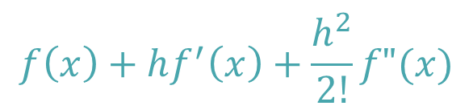
Taylor Series
The Taylor series expansion has a very intuitive interpretation
$$y=f(x)$$
$$f(x)$$
$$f(x)$$
$$f\left(x\right)+hf′(x)$$
$$f\left(x\right)+hf^{′}\left(x\right)+\frac{h^{2}}{2!}f"(x)$$
$$f(x+h)$$
$$x$$
$$x+h$$
$$x$$
Notes:
The Taylor series expansion of a function around a point x has a very intuitive interpretation
Consider a function y=f(x)
Let us expand this function around x, meaning we want to expand the expression f(x+h) for some values of h.
The first term in the Taylor series expansion is f(x).
Graphically it means that we approximate f(x+h) by simply extrapolating horizontally f(x)
If we include one term more, then we get f(x)+hf’(x), which means we extrapolate linearly the function in f(x).
If we include a further term then our extrapolation does not only take into account the tangent of the function in x, but as well it’s curvature.
We get a parabolic extrapolation
Note how, the more term we include in the Taylor series expansion, the extrapolation becomes closer and closer to the actual value f(x+h)
The expansion becomes as well more accurate the smaller with smaller values of h.

Slide 5
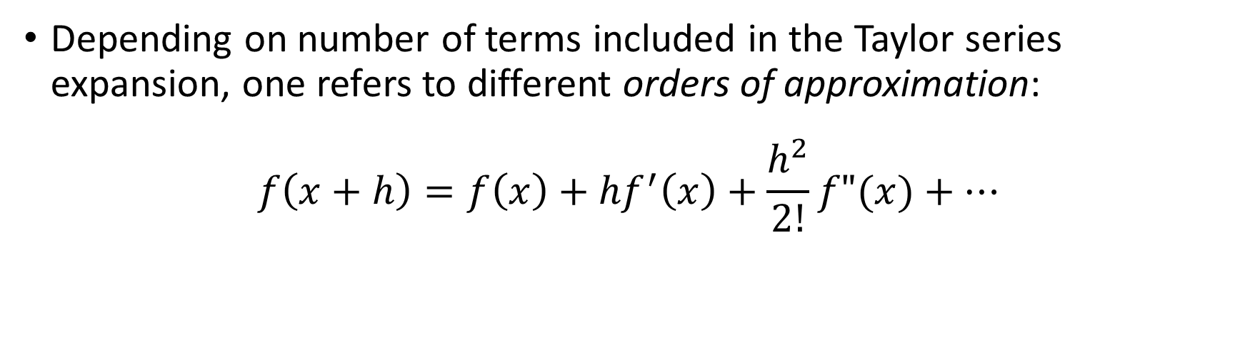
Taylor Series – Order of Approximation
Depending on number of terms included in the Taylor series expansion, one refers to different orders of approximation:
$$f\left(x+h\right)=f\left(x\right)+{hf}^{′}\left(x\right)+\frac{h^{2}}{2!}f"(x)+⋯$$
Zero Order
First Order
Second Order
Notes:
Depending on the number of terms we use in the Taylor series expansion we talk about different order of approximations
Including only the first term is the so-called zero order approximation
If we add the second term we get the first order approximation
Adding one additional term leads us to the third order approximation

Slide 6

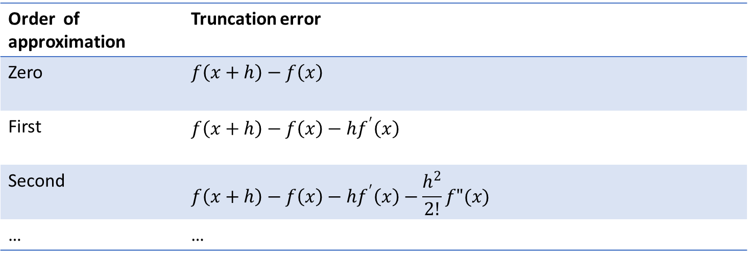
Truncation error of Taylor series
The difference between $f\left(x+h\right)$ and it’s approximation from the Taylor series expansion is the truncation error
This error becomes smaller as one includes more terms:
Order of approximation | Truncation error
Zero | $$f\left(x+h\right)−f\left(x\right)$$
First | $$f\left(x+h\right)−f\left(x\right)−{hf}^{′}\left(x\right)$$
Second | $$f\left(x+h\right)−f\left(x\right)−{hf}^{′}\left(x\right)−\frac{h^{2}}{2!}f"(x)$$
… | …
Notes:
The difference between $f\left(x+h\right)$ and it’s approximation from the Taylor series expansion is the truncation error
As we already noted on the graphical interpretation of the Taylor series expansion, this error becomes smaller and smaller as we include more terms.
It becomes as well smaller if we choose smaller values of h.

Slide 7
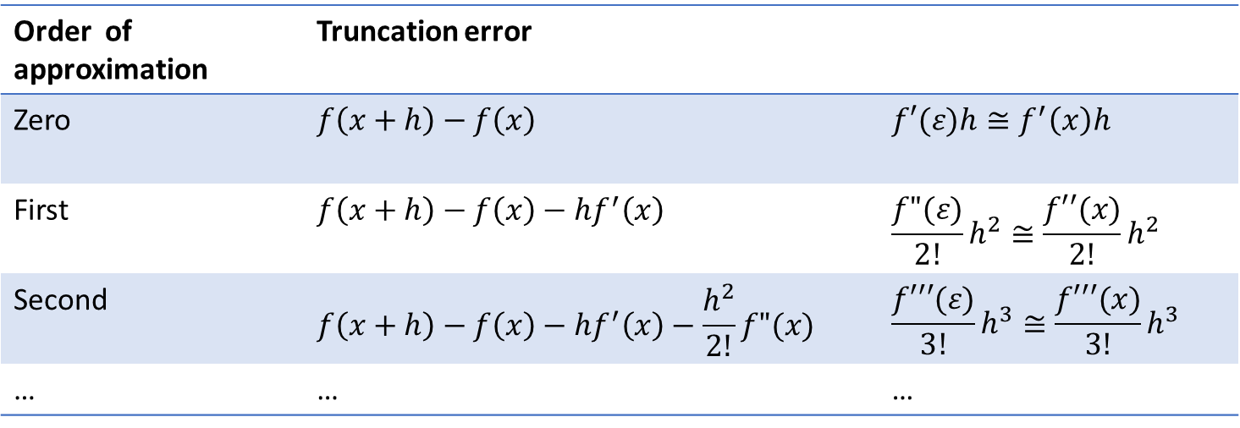
Truncation error of Taylor series
The difference between $f\left(x+h\right)$ and it’s approximation from the Taylor series expansion is the truncation error
This error becomes smaller as one includes more terms:
Order of approximation | Truncation error
Zero | $$f\left(x+h\right)−f\left(x\right)$$ | $$f′(ε)h≅f^{′}\left(x\right)h$$
First | $$f\left(x+h\right)−f\left(x\right)−{hf}^{′}\left(x\right)$$ | $$\frac{f"(ε)}{2!}h^{2}≅\frac{f′′(x)}{2!}h^{2}$$
Second | $$f\left(x+h\right)−f\left(x\right)−{hf}^{′}\left(x\right)−\frac{h^{2}}{2!}f"(x)$$ | $$\frac{f′′′(ε)}{3!}h^{3}≅\frac{f′′′(x)}{3!}h^{3}$$
… | … | …
Notes:
In your calculus courses you learned how to compute the reminder of a Taylor series.
This reminder is in fact the truncation error.
For example, if we use first order approximation this reminder is given by $\frac{f"(ε)}{2!}h$ with epsilon some number between x and x+h
There is no general expression to determine the number epsilon. This will depend on the function f.
As in numerical methods the expansion will be done for small values of h, one can often approximate epsilon by x and consequently the estimation of the truncation error for the first order approximation would be about $\frac{f′′(x)}{2!}h$
We will see in a few slides some example on how to use these expressions.

Slide 8
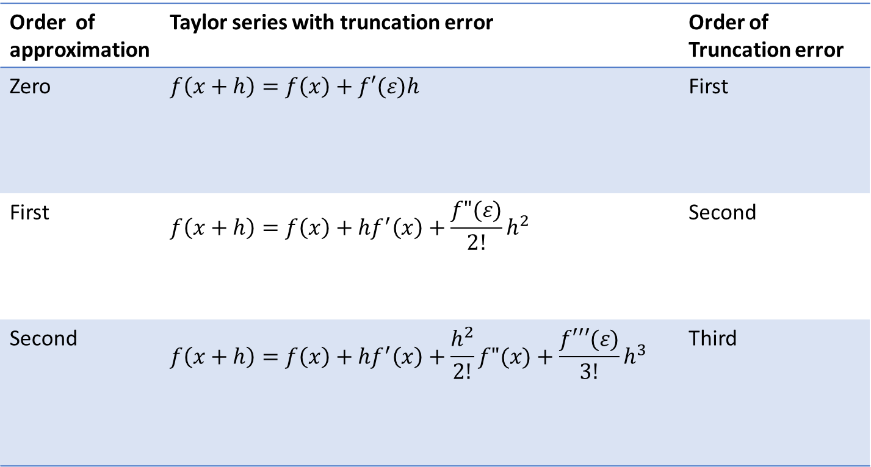
Big “O” notation
Order of approximation | Taylor series with truncation error | Order of Truncation error
Zero | $$f\left(x+h\right)=f\left(x\right)+f′(ε)h$$ | First
First | $$f\left(x+h\right)=f\left(x\right)+{hf}^{′}\left(x\right)+\frac{f"(ε)}{2!}h^{2}$$ | Second
Second | $$f\left(x+h\right)=f\left(x\right)+{hf}^{′}\left(x\right)+\frac{h^{2}}{2!}f"(x)+\frac{f′′′(ε)}{3!}h^{3}$$ | Third
Notes:
Let us add some words on terminology
The order of approximation is given by the highest power of h included in the expansion
For zero order approximation we include up to h power zero.
For first order approximation we include up to h power one.
And for second order approximation we include up to h power two.
In similar way, the order of the truncation error is the power of h in the error term.
For a zero order approximation, the error term is in h power one. Consequently the truncation error is in first order
For a first order approximation, the error term is in h power two. Consequently the truncation error is in second order
And for a second order approximation, the error term is in h power three. Consequently the truncation error is in third order

Slide 9
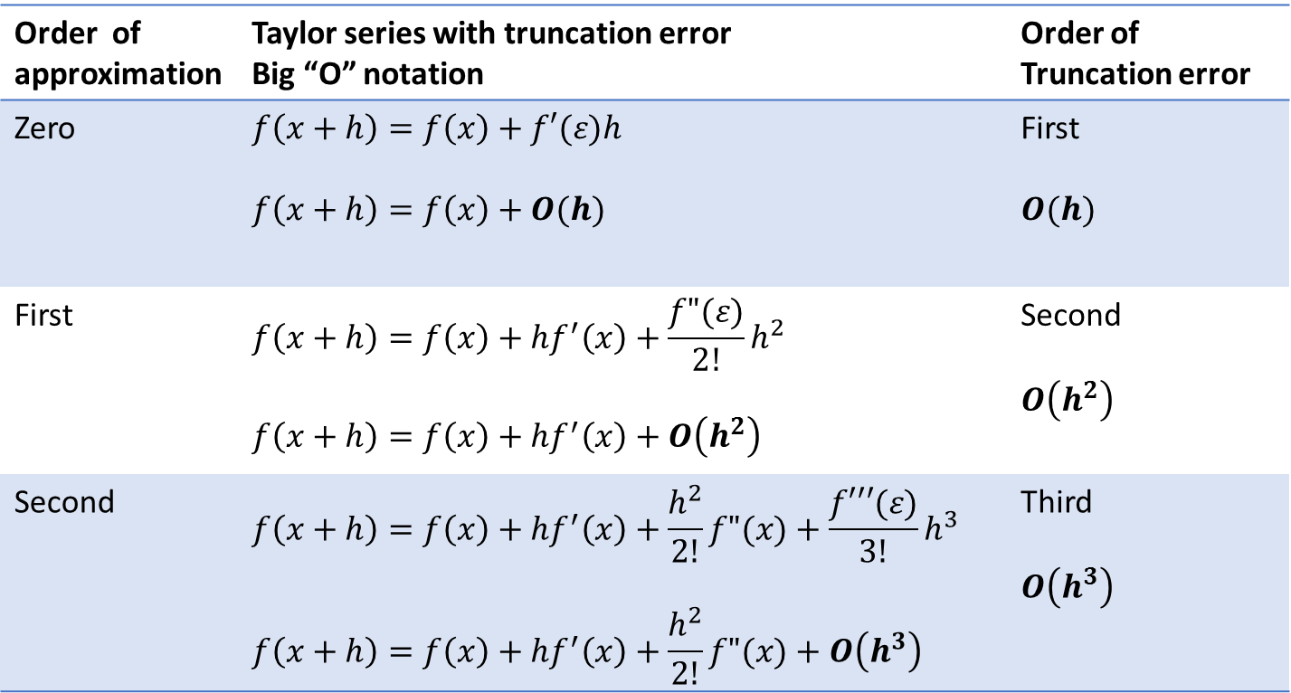
Big “O” notation
Order of approximation | Taylor series with truncation error Big “O” notation | Order of Truncation error
Zero | $$f\left(x+h\right)=f\left(x\right)+f′(ε)h$$ $$f\left(x+h\right)=f\left(x\right)+O(h)$$ | First $$O(h)$$
First | $$f\left(x+h\right)=f\left(x\right)+{hf}^{′}\left(x\right)+\frac{f"(ε)}{2!}h^{2}$$ $$f\left(x+h\right)=f\left(x\right)+{hf}^{′}\left(x\right)+O\left(h^{2}\right)$$ | Second $$O\left(h^{2}\right)$$
Second | $$f\left(x+h\right)=f\left(x\right)+{hf}^{′}\left(x\right)+\frac{h^{2}}{2!}f"(x)+\frac{f′′′(ε)}{3!}h^{3}$$ $$f\left(x+h\right)=f\left(x\right)+{hf}^{′}\left(x\right)+\frac{h^{2}}{2!}f"(x)+O\left(h^{3}\right)$$ | Third $$O\left(h^{3}\right)$$
Notes:
In numerical analysis one likes to use the so called big “O” notation
This notation is used to show the order of an expression.
For a first order truncation error, one will write O(h), meaning that the error term is in power one in h.
For a second order truncation error, one will write O(h^2), meaning that the error term is in power two in h.
And for a third order truncation error, one will write O(h^3), meaning that the error term is in power three in h.

Slide 10
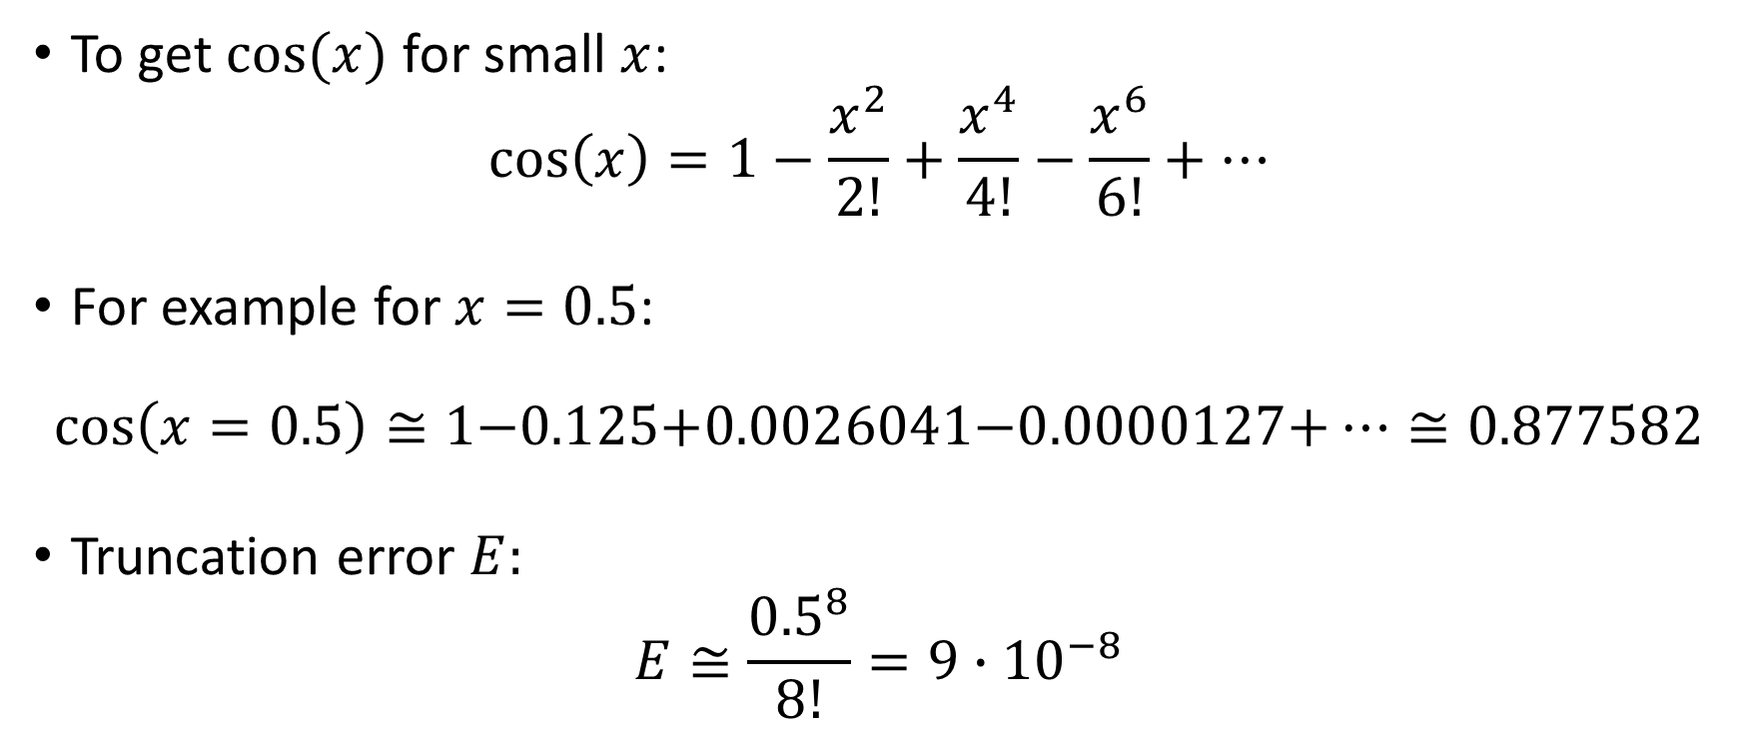
Illustration – Cosine Function
To get $cos⁡(x)$ for small $x$:
$$\cos\left(x\right)=1−\frac{x^{2}}{2!}+\frac{x^{4}}{4!}−\frac{x^{6}}{6!}+…$$
For example for $x=0.5$:
$$\cos\left(x=0.5\right)≅\text{1−0.125+0.0026041−0.0000127+}…≅0.877582$$
Truncation error $E:$
$$E≅\frac{{0.5}^{8}}{8!}=9∙{10}^{−8}$$
Always use radians
Notes:
As an illustration we will expand the cosine function for small values of x.
The Taylor series expansion of cos(x) around 0 for small values x can be easily found.
I strongly invite you to try to find this Taylor series by yourself.
The expression you see here on the slide includes up to the term of order six.
In fact it includes even up to term of order seven.
Why?
Because the term in order seven is equal to zero. This is as well the case for the terms of order one, there and five.
This is a particularity of this Taylor series expansion.
Using this Taylor series expansion we can estimate the value of cos(0.5).
We can as well estimate the truncation error. This truncation error will be about the magnitude of the next not included term. In our case this would be the term in order eight.
You may want to compare these results with the one you get from your hand calculator.
Be however careful to switch your hand calculator to radian mode.
Why is this needed?
Because the Taylor series expansion for trigonometric functions work only for angles expressed in radians.
As numerical methods will always be based on Taylor series expansion, or other form of series expansion, trigonometric function must always be evaluated in radians.

Slide 11
Summary
Truncation errors are the difference between the solution of the actual mathematical problem one wants to solve and the solution of a simplified problem
Taylor series is common tool to estimate truncation errors
Truncation error is decreased by addition of terms to the Taylor series
The big “O” notation is commonly used to show the order of the truncation error

